Slide 1


SECI1143
Probability & statistical data analysis
CHAPTER 2
Data Description
Innovating Sustainable Solutions

Slide 2
Types of Data Set
Univariate
Multivariate
Bivariate

Slide 3
Univariate Data Set
Univariate data set consists of observations on a single variable made on individuals in a sample or population.
Variable is any characteristic whose value may change from one individual or object to another.
A univariate data set is categorical (or qualitative) if the individual observations are categorical response.
Example: recorded calculator brand.
A univariate data set is numerical (or quantitative) if each observation is a number.
Example: recorded number of calculator purchased.

Slide 4
Multivariate Data Set
Multivariate data set consists of observations on two or more variables made on individuals in a sample or population.
Example: recorded height, weight, pulse rate and systolic blood pressure for each individual in a group.
A bivariate data are special case of multivariate data set because it focus simultaneously on only two variables or two different characteristics.
Example: recorded both height and weight for each individual in a group.

Slide 5
Displaying Categorical Data
An appropriate graphical or tabular of data can be an effective way to summarize and communicate information.
Example:
Frequency distribution or frequency table
Bar chart
Pie chart
Dot-Plot

Slide 6
Frequency Distribution
A frequency distribution for categorical data is a table that displays the possible categories along with the associated frequencies and/or relative frequencies.
The frequency for a particular category is the number of times the category appears in the data set.
The relative frequency for a particular category is the fraction or proportion of the observations resulting in the category.
Frequency distributions are portrayed as frequency tables, dot plot, histograms, or polygons.

Slide 7
Example
Data – Staff info at School of Computing
Staff | Position | Blood Type | Weight | Height | Qualification
1 | Senior Lecturer | A | 60 | 165 | PhD
2 | Lecturer | B | 55 | 150 | Master
3 | Professor | O | 65 | 170 | PhD
4 | Associate Professor | AB | 70 | 175 | PhD
5 | Associate Professor | O | 61 | 160 | PhD
6 | Senior Lecturer | O | 58 | 155 | PhD
7 | Senior Lecturer | B | 48 | 167 | PhD
8 | Lecturer | A | 68 | 174 | Master
9 | Lecturer | A | 55 | 150 | Master
10 | Associate Professor | AB | 62 | 163 | PhD
11 | Professor | O | 58 | 165 | PhD
… | … | … | … | … | …
140 | Tutor | O | 45 | 150 | Master

Slide 8
Example
Frequency Table: Staff distribution in School of Computing
Position | Number of Staff (Frequency)
Professor | 12
Associate Professor | 20
Senior Lecturer | 59
Lecturer | 40
Tutor | 9
Total | 140
7

Slide 9
Example
Position | Frequency | Relative Frequency
Professor | 12 | 12 ÷ 140 = 0.09
Associate Professor | 20 | 0.14
Senior Lecturer | 59 | 0.42
Lecturer | 40 | 0.29
Tutor | 9 | 0.06
Total | 140 | 1.00

Slide 10
Example
Data
Age | NetUse | Age | NetUse | Age | NetUse
26.0 | Yes | 45.0 | No | 55.0 | No
48.0 | Yes | 19.0 | No | 37.0 | No
67.0 | Yes | 82.0 | No | 43.0 | Yes
44.0 | No | 83.0 | No | 29.0 | Yes
52.0 | No | 20.0 | Yes | 57.0 | Yes
52.0 | No | 89.0 | No | 36.0 | No
51.0 | Yes | 88.0 | Yes | 52.0 | No
52.0 | No | 72.0 | Yes | 56.0 | Yes
77.0 | No | 82.0 | Yes | 66.0 | Yes
40.0 | No | 34.0 | No | 46.0 | No

Slide 11
Example
List the variables involved and calculate the frequency
Other types of response with missing value:
DK (Don’t know)
NAP (Not applicable)
NA (No answer/response)
Response | Frequency
No | 17
Yes | 13

Slide 12
Example
Calculate the percent, valid percent and cumulative percent
Valid percent: excludes data with missing value (ie. DK, NAP, and NA)
Response | Frequency | Percent | Valid Percent | Cumulative Percent
No | 17 | 56.7 | 56.7 | 56.7
Yes | 13 | 43.3 | 43.3 | 100.0
Total | 30 | 100.0 | 100.0

Slide 13
Exercise
The data below represent the color of M&Ms in a bag of plain M&Ms. Construct a frequency distribution of the color of plain M&Ms.
Yellow | Orange | Brown | Green | Green
Blue | Brown | Red | Brown | Brown
Orange | Brown | Red | Brown | Red
Green | Brown | Red | Green | Yellow
Yellow | Red | Red | Brown | Orange
Yellow | Orange | Red | Orange | Blue
Brown | Red | Yellow | Brown | Red
Brown | Yellow | Yellow | Blue | Yellow
Yellow | Brown | Yellow | Green | Orange

Slide 14
Solution
Color Type | Frequency | Relative Frequency
Yellow | 10 | 0.22
Blue | 3 | 0.07
Orange | 6 | 0.13
Green | 5 | 0.11
Brown | 12 | 0.27
Red | 9 | 0.20
Total | 45 | 1.00

Slide 15
Bar Chart
A bar chart is a graph of the frequency distribution of categorical data.
Each category in the frequency distribution is represented by a bar or rectangle.
How to construct:
Draw a horizontal line, and write the category names or labels below the line at regularly spaced intervals.
Draw a vertical line, and label the scale using either frequency or relative frequency.
Place a rectangular bar above each category label. The height is determined by the category’s frequency or relative frequency, and all bars should have the same width.
What to look for:
Frequently and infrequently categories.

Slide 16
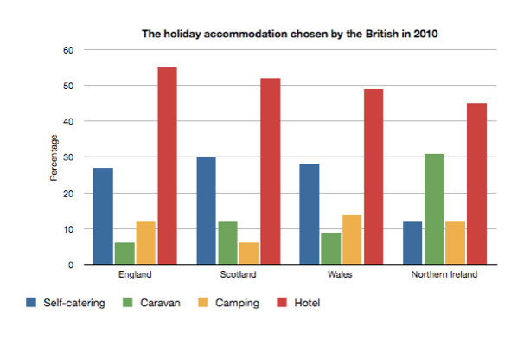
Example

Slide 17
Example
Number of Staff
Position

Slide 18
Example
Relative
Frequency
Position

Slide 19
Example
Position
Percent of Staff (%)

Slide 20
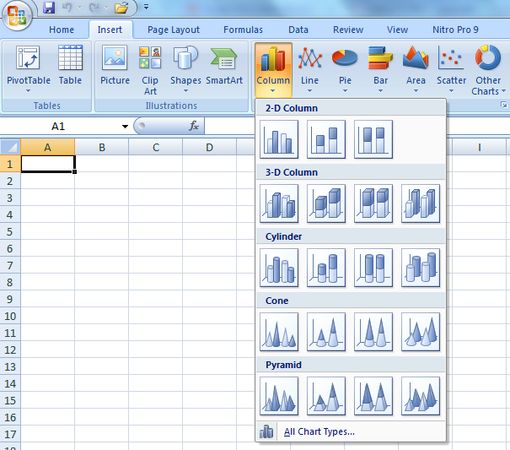
Statistical Tools
Excel:

Slide 21
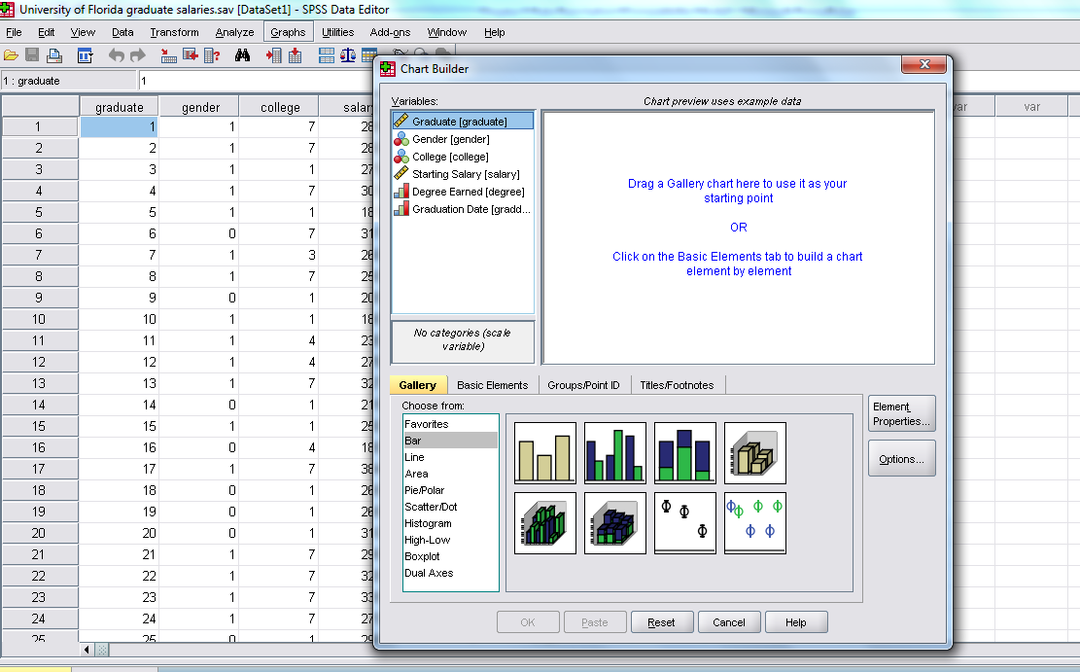
Statistical Tools
SPSS:

Slide 22
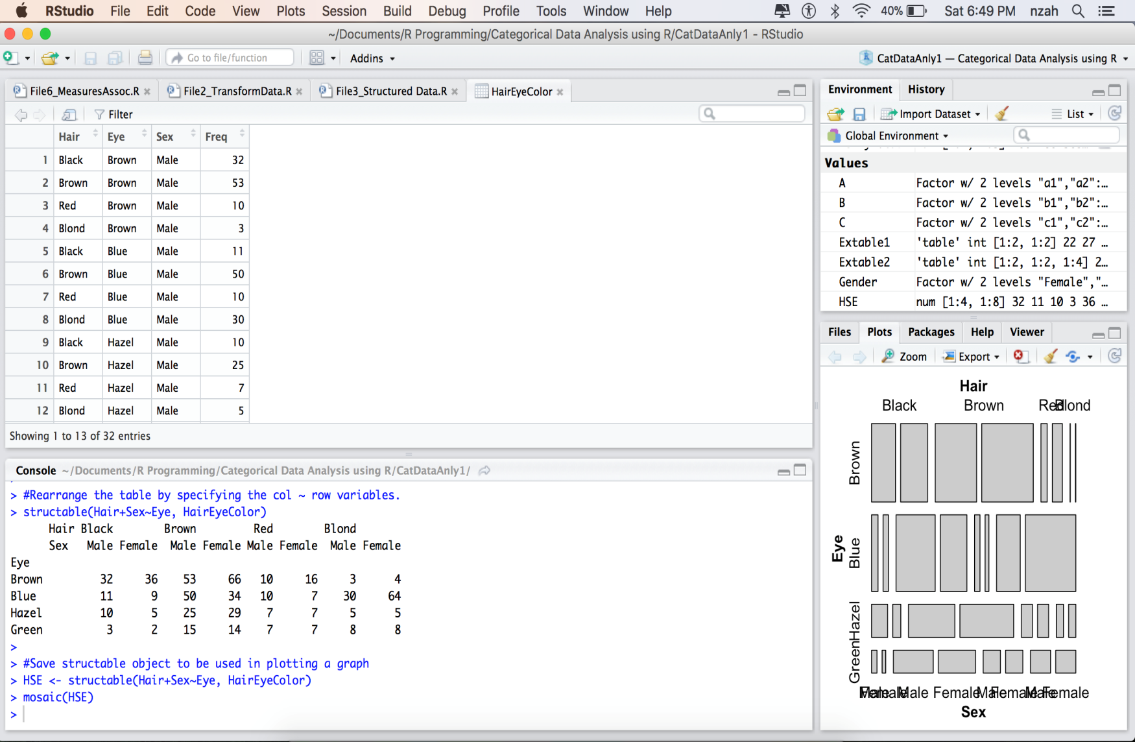
Statistical Tools
R :

Slide 23
Comparative Bar Charts
Bar chart can also be used to give a visual comparison of two or more groups.
When constructing a comparative bar graph we use the relative frequency rather than the frequency to construct the scale on the vertical axis so that we can make meaningful comparisons even if the sample sizes are not the same.

Slide 24
Example
Source of Funding | Frequency |  | Relative Frequency
 | Female | Male | Female | Male
Student Loans | 50 | 30 | 0.5 | 0.50
Parents and/or family | 30 | 20 | 0.3 | 0.33
Scholarships | 20 | 10 | 0.2 | 0.17
Total | 100 | 60 | 1.00 | 1.00

Slide 25
Example
Frequency
Relative frequency
Inaccurate comparative bar chart
Accurate comparative bar chart

Slide 26
Pie Charts
In a pie chart, a circle is used to represent the whole data set, with “slices” of the pie representing the possible categories.
The size of the slice for a particular category is proportional to the corresponding frequency or relative frequency.
Pie charts are most effective for summarizing data sets when there are not too many different categories.

Slide 27
Pie Charts
How to construct
Draw a circle to represent the entire data set
For each category, calculate the “slice” size.
slice size = 360 (category relative frequency)
Draw a slice of appropriate size for each category.
What to look for
Categories that form large and small proportions of the data set.

Slide 28
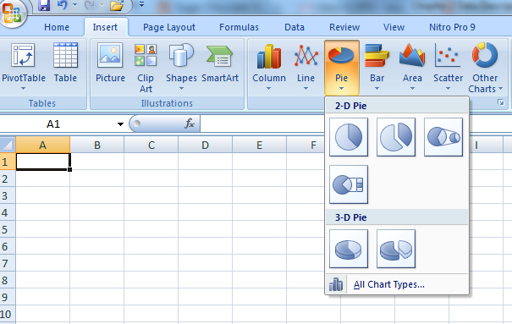
Statistical Tools
Excel:

Slide 29
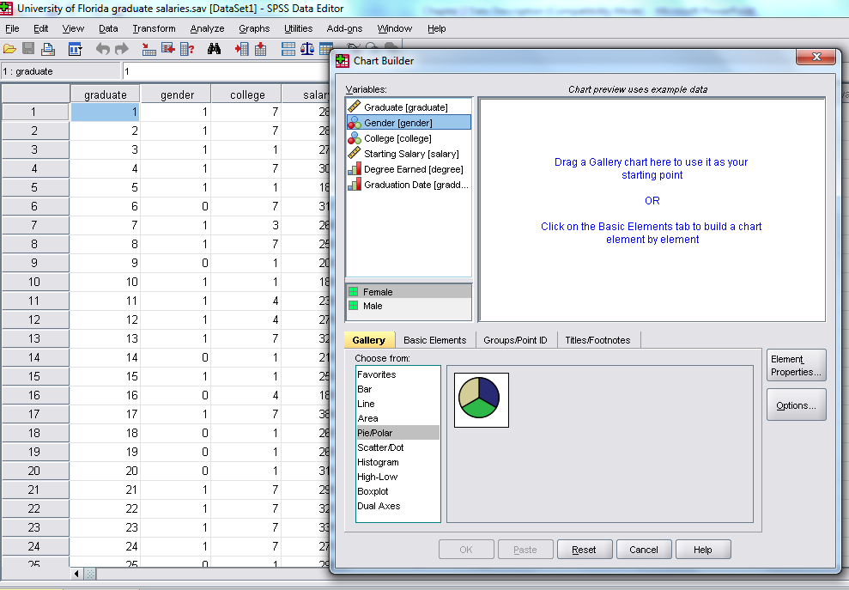
Statistical Tools
SPSS:

Slide 30
Example

Slide 31
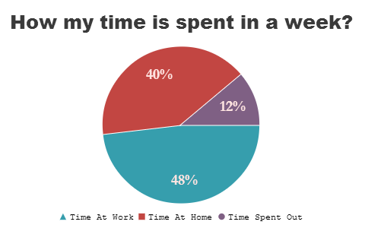
Example

Slide 32
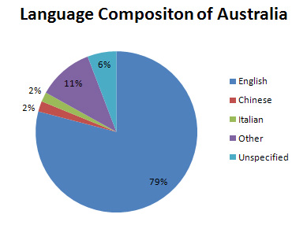
Example

Slide 33
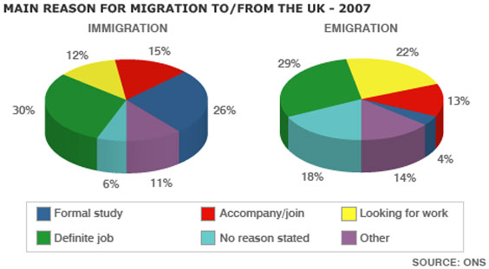
Example

Slide 34
Exercise
Travel Survey
92 people were asked how they got to work:
35 used a car
42 took public transport
8 rode a bicycle
7 walked
Calculate the relative frequency.
Draw the appropriate chart.

Slide 35
Displaying Numerical Data
Ungrouped data comprise a listing of the observed values.
Grouped data represent a lumping together of the observed values.
The data can be discrete or continuous.

Slide 36
Example
Ungrouped data
0 1 3 0 1 0 1 0
1 5 4 1 2 1 2 0
1 0 2 0 0 2 0
2 1 1 …..

Slide 37
Example
Ungrouped data
2.559 | 2.556 | 2.566 | 2.546 | 2.561 | 2.570 | 2.546
2.565 | 2.543 | 2.538 | 2.560 | 2.560 | 2.545 | 2.551
2.568 | 2.546 | 2.555 | 2.551 | 2.554 | 2.574 | 2.568
2.572 | 2.550 | 2.556 | 2.551 | 2.561 | 2.560 | 2.564
2.567 | 2.560 | 2.551 | 2.562 | 2.542 | 2.549 | 2.561
36

Slide 38
Example
Grouped data
Frequency distribution
Data | Frequency
0 1 2 3 : : | 15 20 8 5 : :
37

Slide 39
Example
Grouped data
Frequency distribution
Data | Frequency
2.531 - 2.535 2.536 – 2.540 2.541 – 2.545 2.546 – 2.550 : : | 6 8 12 13 : :
38

Slide 40
Frequency Distributions
A frequency distribution shows the number of observations falling into each of several ranges of values.
Frequency distributions are portrayed as frequency tables, histograms, or polygons.
Frequency distributions can show either the actual number of observations falling in each range or the percentage of observations. In the latter instance, the distribution is called a relative frequency distribution.

Slide 41
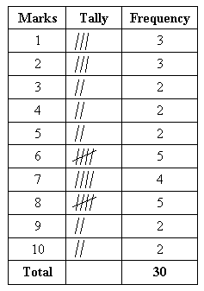
Example
Discrete Data:
5 7 7 1 3 2 8 6 8 2 4 4 9 10 2 6 3 1 6 6 9 9 7 5 7 10 8 1 5 8

Slide 42
Frequency distribution table (details):
Marks | Frequency | Relative Frequency | Cumulative Frequency (CF) | Percent (%) of CF
1 2 3 4 5 6 7 8 9 10 | 3 3 2 2 3 4 4 4 3 2 | 0.100 0.100 0.067 0.067 0.100 0.133 0.133 0.133 0.100 0.067 | 0.1 0.2 0.267 0.334 0.434 0.567 0.7 0.833 0.933 1.00 | 10.0 20.0 26.7 33.4 43.4 56.7 70.0 83.3 93.3 100.00
Total | 30 | 1.000 | 100.00

Slide 43
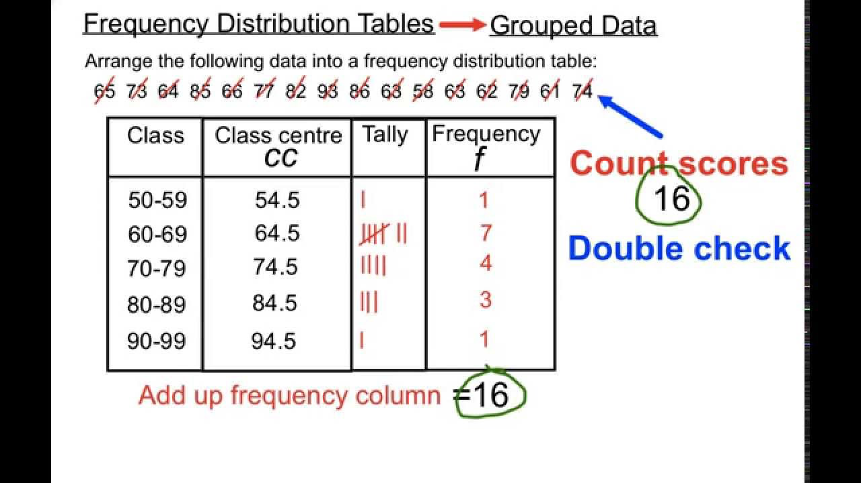
Example
Frequency distribution table for grouped data (discrete data):

Slide 44
Example
Continuous data:
5.1 14.6 10.3 17.0
12.1 18.3 21.4 15.4
22.4 29.7 15.3 19.5
23.3 28.1 16.9 24.9
Continuous data:
5.1 14.6 10.3 17.0
12.1 18.3 21.4 15.4
22.4 29.7 15.3 19.5
23.3 28.1 16.9 24.9
Class Interval | Frequency
5 to <10 | 1
10 to <15 | 3
15 to <20 | 6
20 to <25 | 4
25 to <30 | 2

Slide 45
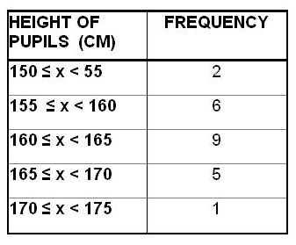
Example
Frequency table for grouped (continuous data):

Slide 46
Dotplots
When to use: Small numerical data sets.
How to construct:
Draw a horizontal line and mark it with an appropriate measurement scale.
Locate each value in the data set along the measurement scale, and represent it by a dot. If there are two or more observations with the same value, stack the dots vertically.
What to look for:
A representative or typical value in the data set.
The extent to which the data values spread out.
The nature of the distribution of values along the number line.
The presence of unusual values in the data set.

Slide 47

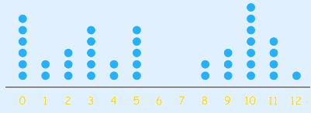
Dotplots
A graphical data using dots.
Example: Minutes To Eat Breakfast
A survey of "How long does it take you to eat breakfast?" has these results:
Which means that 6 people take 0 minutes to eat breakfast (they probably had no breakfast!), 2 people say they only spend 1 minute having breakfast, etc. The dot plot shown below,

Slide 48
Histograms
A histogram is the most commonly used graph to show frequency distributions.
A histogram consists of a set of rectangles that represent the frequency in each categories.
It represents graphically the frequencies of the observed values

Slide 49
Histograms
What to look for:
Central or typical value
Extent of spread or variation
General shape
Location and number of peaks
Presents of gap and outliers

Slide 50
How to construct:
Histograms
Collect data and construct a tally sheet:
The number of cells should be between 5 and 20.
Use 5 to 9 cells when the number of observation <100.
Use 8 to 17 (between 100 and 500).
Use 15 to 20 (>500).
Determine the range:
R = X_{h} – X_{l}
Where R = range, X_{h} = highest number, X_{l} = lowest number

Slide 51
Histograms
Determine the cell interval:
The distance between adjacent cell midpoints.
An odd interval is recommended, so that the midpoint values will be the same number of decimal places as the data values.
Sturgis’ rule:
(n = number of observations)
Trial and error, h = R/i
(h = number of cells, R = range)

Slide 52
Histograms
Determine the cell midpoint:
The lowest cell midpoint must be located to include the lowest data value in its cell.
The simplest technique is to select the lowest data point as the midpoint value for the first cell.
Use formula:
(do not round-up/down the answer)
MP_{l} = midpoint for lowest cell

Slide 53
Histograms
Determine the cell boundaries:
Cell boundaries are the extreme or limit values of a cell (upper boundary and lower boundary)
All the observations that fall between the upper and lower boundaries are classified into that particular cell.
The boundary values are an extra decimal place or significant figure in accuracy than the observed values
Post the cell frequency.
Construct the histogram.

Slide 54
Histograms
Interval
Cell
Midpoint
Lower
boundary
Upper boundary

Slide 55
Example: Data of Steel Shaft Weight (kg)
Draw the histogram for the following data.
2.559 | 2.556 | 2.566 | 2.546 | 2.561 | 2.570 | 2.546
2.565 | 2.543 | 2.538 | 2.560 | 2.560 | 2.545 | 2.551
2.568 | 2.546 | 2.555 | 2.551 | 2.554 | 2.574 | 2.568
2.572 | 2.550 | 2.556 | 2.551 | 2.561 | 2.560 | 2.564
2.567 | 2.560 | 2.551 | 2.562 | 2.542 | 2.549 | 2.561
2.556 | 2.550 | 2.561 | 2.558 | 2.556 | 2.559 | 2.557
2.532 | 2.575 | 2.551 | 2.550 | 2.559 | 2.565 | 2.552
2.560 | 2.534 | 2.547 | 2.569 | 2.559 | 2.549 | 2.544
2.550 | 2.552 | 2.536 | 2.570 | 2.564 | 2.553 | 2.558
2.538 | 2.564 | 2.552 | 2.543 | 2.562 | 2.571 | 2.553
2.539 | 2.569 | 2.552 | 2.536 | 2.537 | 2.532 | 2.552
2.575 (highest) | 2.545 | 2.551 | 2.547 | 2.537 | 2.547 | 2.533
2.538 | 2.571 | 2.545 | 2.545 | 2.556 | 2.543 | 2.551
2.569 | 2.559 | 2.534 | 2.561 | 2.567 | 2.572 | 2.558
2.542 | 2.574 | 2.570 | 2.542 | 2.552 | 2.551 | 2.553
2.546 | 2.531 (lowest) | 2.563 | 2.554 | 2.544

Slide 56
Calculate the frequency – used tally sheet.
Weight | Tabulation | Frequency | Weight | Tabulation | Frequency | Weight | Tabulation | Frequency
2.531 | | | 1 | 2.546 | |||| | 4 | 2.561 | |||| | 5
2.532 | || | 2 | 2.547 | ||| | 3 | 2.562 | || | 2
2.533 | | | 1 | 2.548 |  | 0 | 2.563 | | | 1
2.534 | || | 2 | 2.549 | || | 2 | 2.564 | ||| | 3
2.535 |  | 0 | 2.550 | |||| | 4 | 2.565 | || | 2
2.536 | || | 2 | 2.551 | |||| ||| | 8 | 2.566 | | | 1
2.537 | || | 2 | 2.552 | |||| | | 6 | 2.567 | || | 2
2.538 | ||| | 3 | 2.553 | ||| | 3 | 2.568 | || | 2
2.539 | | | 1 | 2.554 | || | 2 | 2.569 | ||| | 3
2.540 |  | 0 | 2.555 | | | 1 | 2.570 | ||| | 3
2.541 |  | 0 | 2.556 | |||| | 5 | 2.571 | || | 2
2.542 | ||| | 3 | 2.557 | | | 1 | 2.572 | || | 2
2.543 | ||| | 3 | 2.558 | ||| | 3 | 2.573 |  | 0
2.544 | || | 2 | 2.559 | |||| | 5 | 2.574 | || | 2
2.545 | |||| | 4 | 2.560 | |||| | 5 | 2.575 | || | 2

Slide 57
Calculate the range.
Calculate the cell interval – use Sturgis’ rule.

Slide 58
Trial and error
Based on the guidelines, 0.005 will give the best presentation of the data.

Slide 59
Calculate the cell midpoint.
The simplest technique is to select the lowest data point (2.531) as the midpoint value for the first cell.
A better technique is to use the formula:
Cell midpoint
2.533
2.538
2.543
2.548
2.553
2.558
2.563
2.568
2.573

Slide 60
Determine the cell boundaries.
The boundary values are an extra decimal place or significant figure in accuracy than the observed values.
Example:
Lower boundary
2.5305
Midpoint
2.533
Upper boundary
2.5355
2.531
2.532
2.534
2.535
0.005
(Range)

Slide 61
Post the cell frequency.
Cell Boundaries | Cell Midpoint | Frequency
2.5305 – 2.5355 | 2.533 | 6
2.5355 – 2.5405 | 2.538 | 8
2.5405 – 2.5455 | 2.543 | 12
2.5455 – 2.5505 | 2.548 | 13
2.5505 – 2.5555 | 2.553 | 20
2.5555 – 2.5605 | 2.558 | 19
2.5605 – 2.5655 | 2.563 | 13
2.5655 – 2.5705 | 2.568 | 11
2.5705 – 2.5755 | 2.573 | 8

Slide 62
Draw the histogram.
25
20
15
Frequency
10
5
0
2.533
2.538
2.543
2.548
2.553
2.558
2.563
2.568
2.573
Steel weight (kg)

Slide 63
Frequency Polygon
Relative frequencies of class intervals can also be shown in a frequency polygon.
In a frequency distribution, the mid-value of each class is obtained.
The frequency is plotted against the corresponding mid-value.
These points are joined by straight lines.
These straight lines may be extended in both directions to meet the X - axis to form a polygon.

Slide 64
Example
Histogram & Polygon
25
20
15
Frequency
10
5
0
2.533
2.538
2.543
2.548
2.553
2.558
2.563
2.568
2.573
Steel weight (kg)

Slide 65
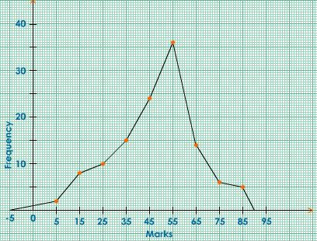
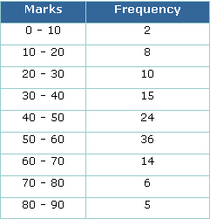
Polygon
Example

Slide 66
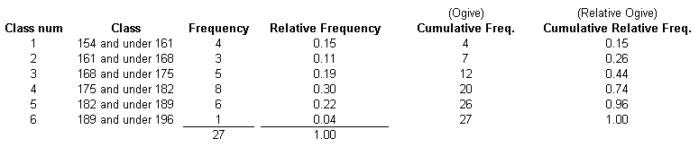
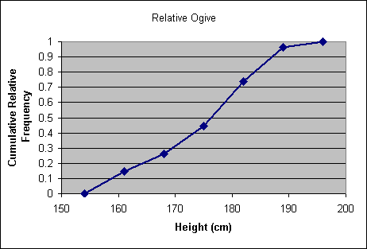
Ogive
A plot of the cumulative frequency against the upper class boundary with the points joined by line segments.
Example:

Slide 67
Stem-and-Leaf
A stem-and-leaf display is an effective and compact way to summarize univariate numerical data.
Each number in the data set is broken into two pieces, a stem and a leaf.
The stem is the first part of the number and consists of the beginning digit(s).
The leaf is the last part of the number and consists of the final digit(s).

Slide 68
When to use:
Numerical data sets with a small to moderate number of observations (does not work well for very large data sets)
How to construct:
Select one or more leading digits for the stem values. The trailing digits (or sometimes just the first one of the trailing digits) become the leaves.
List possible stem values in a vertical column.
Record the leaf for every observation beside the corresponding stem value.
Indicate the units for stems and leaves someplace in the display.

Slide 69
What to look for:
The display conveys information about
a representative or typical value in the data set
the extent of spread about a typical value
the presence of any gaps in the data
the extent of symmetry in the distribution of values
the number and location of peaks

Slide 70
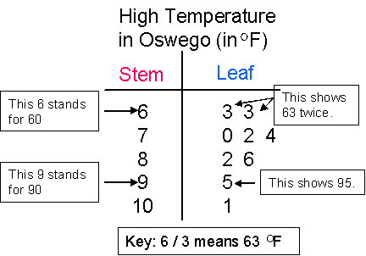
Example
Dataset:
63, 70, 74, 63, 82, 72, 95, 101, 86
Stem: tens ; leaf: ones

Slide 71
Exercise
Make a stem-and-leaf plot for the following list of numbers:
2.1, 2.0, 3.2, 3.7, 1.4, 1.5, 2.6
b) Make a stem-and-leaf plot for the following
list of numbers:
23, 19, 28, 45, 36, 47, 48, 50, 51, 13

Slide 72
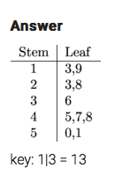
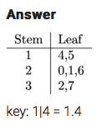
Solution
a)
b)

Slide 73
Box Plots
Box plots – a method that can summarize data that gives more detail than just a measure of center and spread and yet less detail than a stem-and-leaf display or histogram.
It is compact, yet it provides information about center, spread, and symmetry or skewness of the data.

Slide 74
Box plots graphically display five key statistics of a data set:
Minimum
First quartile
Median
Third quartile
Maximum
Very useful in identifying the shape of a distribution and outliers in data set.

Slide 75
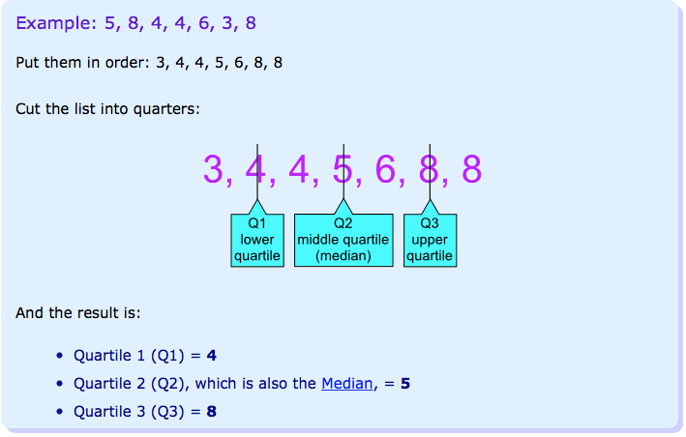
Quartiles
Quartiles are the values that divide a list of numbers into quarters.
First put the list of numbers in order.
Then cut the list into four equal parts.
The Quartiles are at the "cuts”.

Slide 76
How To Calculate Quartile
Sort the data set so measurements are in order from lowest to highest,
Y[1], Y[2], …. , Y[N]
Calculate,
{Note: Q1: P = 25; Q2: P = 50; Q3: P = 75}
If i is not an integer, round up to the next highest integer k and use Y[k] as the quartile estimate.
If i is an integer, use (Y[i] +Y[i+1]) ÷ 2 as the quartile estimate.

Slide 77
Example
Given set of data:
12, 4, 6, 11, 9,15, 20, 18, 25, 30.
Calculate 1^{st ,} 2nd and 3rd quartile.
Solution (i): 1st quartile (Q1)
Arrange in order:
4 6 9 11 12 15 18 20 25 30
N = 10, P = 25 ; i = 25 x 10 ÷ 100 = 2.5, k = 3
Y[3] = 9, .: Q1 = 9

Slide 78
Solution (ii): 2nd quartile (Q2)
Arrange in order:
4 6 9 11 12 15 18 20 25 30
N = 10, P = 50 ; i = 50 x 10 ÷ 100 = 5, k = 5
(Y[5] + Y[6]) ÷ 2 = (12 + 15) ÷ 2 = 13.5, .: Q2 = 13.5
Solution (iii): 3rd quartile (Q3)
N = 10, P = 75 ; i = 75 x 10 ÷ 100 = 7.5, k = 8
Y[8] = 20, .: Q3 = 20

Slide 79
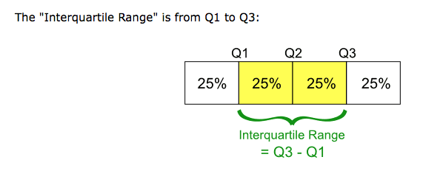

Slide 80
2 types of boxplots:
Skeletal boxplot
Modified boxplot

Slide 81
Skeletal Box Plots
Construction of a Skeletal Boxplot
Draw a vertical (or horizontal ) measurement scale
Construct a rectangular box with a lower (or left) edge at the lower quartile and a upper (or right ) edge at the upper quartile.
The box width is then equal to the interquartile range (iqr)
iqr = upper quartile – lower quartile
Draw a horizontal (or vertical) line segment inside the box at the location of the median.
Extend vertical (or horizontal) line segments, call whiskers, from each of the box to the smallest and largest observations in the data set.

Slide 82
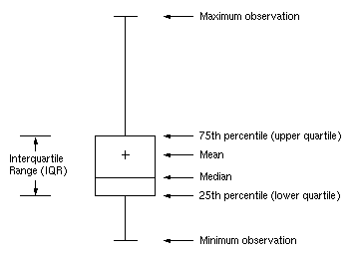
Example – Skeletal Box plot

Slide 83
Modified Box Plots
An observation is an outlier if it is more than 1.5(iqr) away from the nearest quartile (the nearest end of the box)
An outlier is extreme if it is more than 3(iqr) from the nearest end of the box, and it is mild otherwise.
A modified boxplot represent mild and extreme outliers, and the whiskers extend on each end to the most extreme observations that are not outliers.

Slide 84
Outliers
For a modified box plot, the whiskers are the lines that extend from the left and right of the box to the adjacent values. The adjacent values are defined as the lowest and highest observations that are still inside the region defined by the following limits:
Lower Limit: Q1 − 1.5 × IQR
Upper Limit: Q3 + 1.5 × IQR
In general, values that fall outside of the adjacent value region are deemed outliers.

Slide 85
Construction of a Modified Boxplot:
Draw a vertical (or horizontal) measurement scale
Construct a rectangular box with a lower (or left) edge at the lower quartile and a upper (or right ) edge at the upper quartile.
The box width is then equal to iqr.
Draw a horizontal (or vertical) line segment inside the box at the location of the median.
Determine if there are any mild or extreme outliers in the data set.
Draw whiskers that extend from each end of the box to the most extreme observation that is not an outlier.
Draw a + to mark the location if any mild outliers or extreme outliers in the data set.

Slide 86
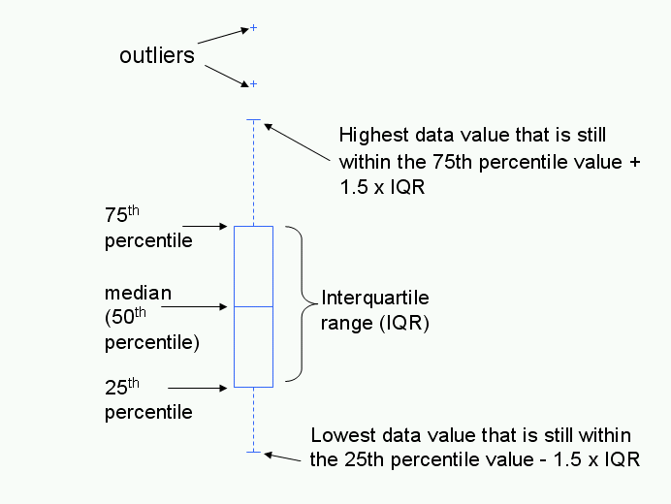
Example – Modified Box plot

Slide 87
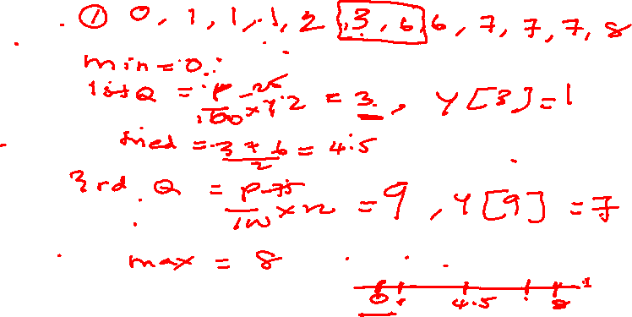
Exercise
Draw a box plot for the following set of data.
Remember to order the data first, if necessary.
1, 0, 3, 2, 1, 1, 7, 8, 6, 6, 7, 7

Slide 88
Exercise
b) Draw a box plot for the following set of data.
Remember to order the data first, if necessary.
4.7, 3.8, 3.9, 3.9, 4.6, 4.5, 5

Slide 89
Exercise
c) Draw a skeletal & modified box plot for the following set of data. Remember to order the data first, if necessary.
5,6,12,13,15,18,22,50

Slide 91
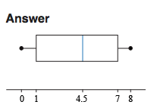
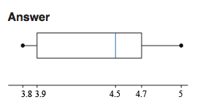
Solution
a)
b)

